Slide 1


Common Cloud Operations in Microsoft Azure and AWS
Tim Warner

Slide 2

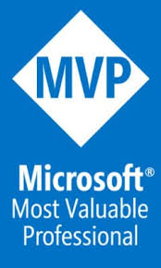

Tim Warner
Based in Nashville, TN, US
MCT, MVP
Twitter: @TechTrainerTim
Badge: TechTrainerTim.com

Slide 3
Session 1 of 2 Learning Goals
Introduction
General comparisons
Storage
Compute & Networking

Slide 4
Session 2 of 2 Learning Goals
Compute & Networking, Concluded
Identity and Security
Monitoring
Pricing, Governance, Compliance

Slide 5
Course Materials
timw.info/azureaws

Slide 6
Setting Expectations
10-minute break at midpoint
Please ask/answer questions and provide feedback in the Q/A panel, not the group chat
I'll post outstanding questions/answers to my Twitter feed: @TechTrainerTim

Slide 7
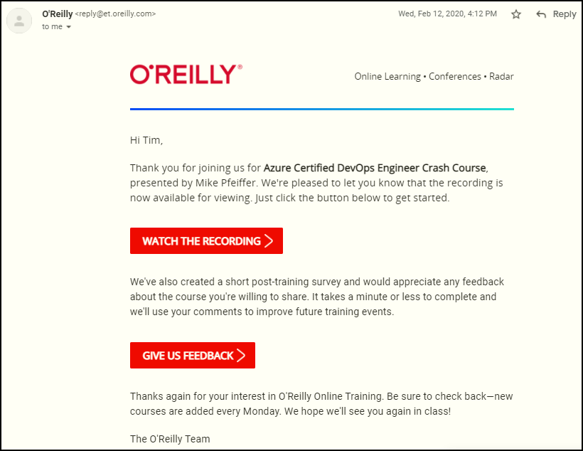
Session Recordings

Slide 8

Session Recordings

Slide 9

Session Recordings

Slide 10


Session Recordings

Slide 11
Thank you!
Course materials: timw.info/azureaws
Twitter: @TechTrainerTim
Work: timw.info/ps
Web: TechTrainerTim.com

Slide 12
General Comparison

Slide 13
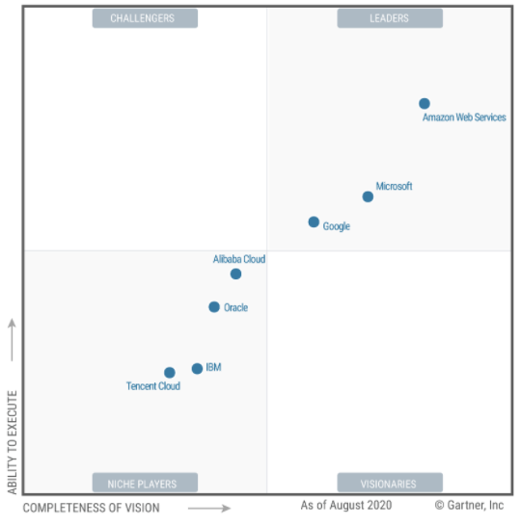

Gartner Magic Quadrant 2020
https://timw.info/ea056

Slide 14

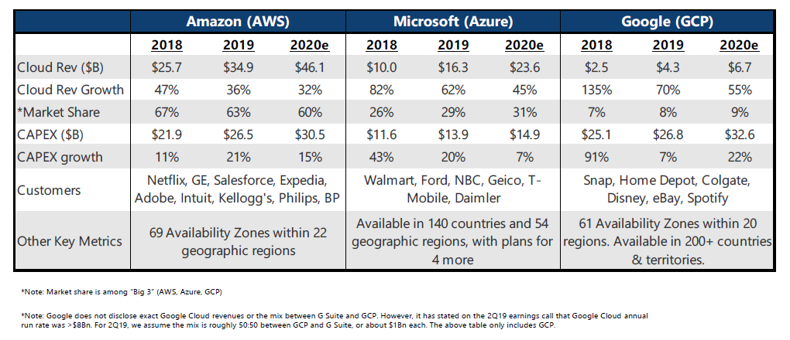
Revenue and Market Share (ZDNet)
https://timw.info/fa5a6

Slide 15




Amazon Web Services - Timeline
April 2015: Machine learning
Jan 2012: DynamoDB
Oct 2009: RDS
Nov 2008: CloudFront CDN
Aug 2008: EBS
Aug 2006: EC2
March 2006: Launch, S3

Slide 16

Microsoft Azure - Timeline
April 2014: Rename to Microsoft Azure; Azure Resource Manager (ARM)
June 2012: Websites, VMs, new portal
Feb 2010: Commercial availability
Nov 2009: PHP, Java
Mar 2009: SQL Azure; websites
Oct 2008: Initial announcement

Slide 17
Management Interfaces
Web Portal
Azure Portal/AWS Management Console
REST APIs
Azure/AWS SDKs
CLI
Azure CLI/AWS CLI
PowerShell
Azure PowerShell/AWS Tools for PowerShell
JSON Templates
ARM templates/AWS CloudFormation templates

Slide 18
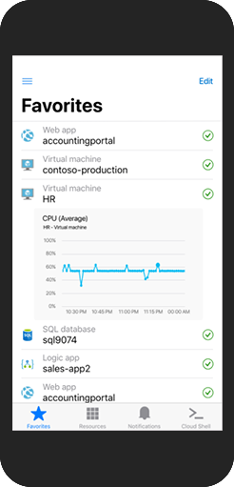
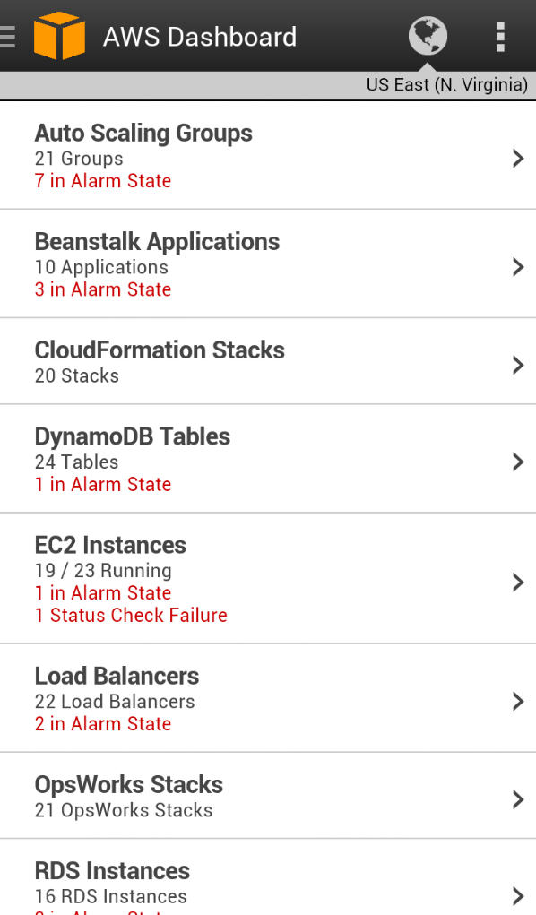
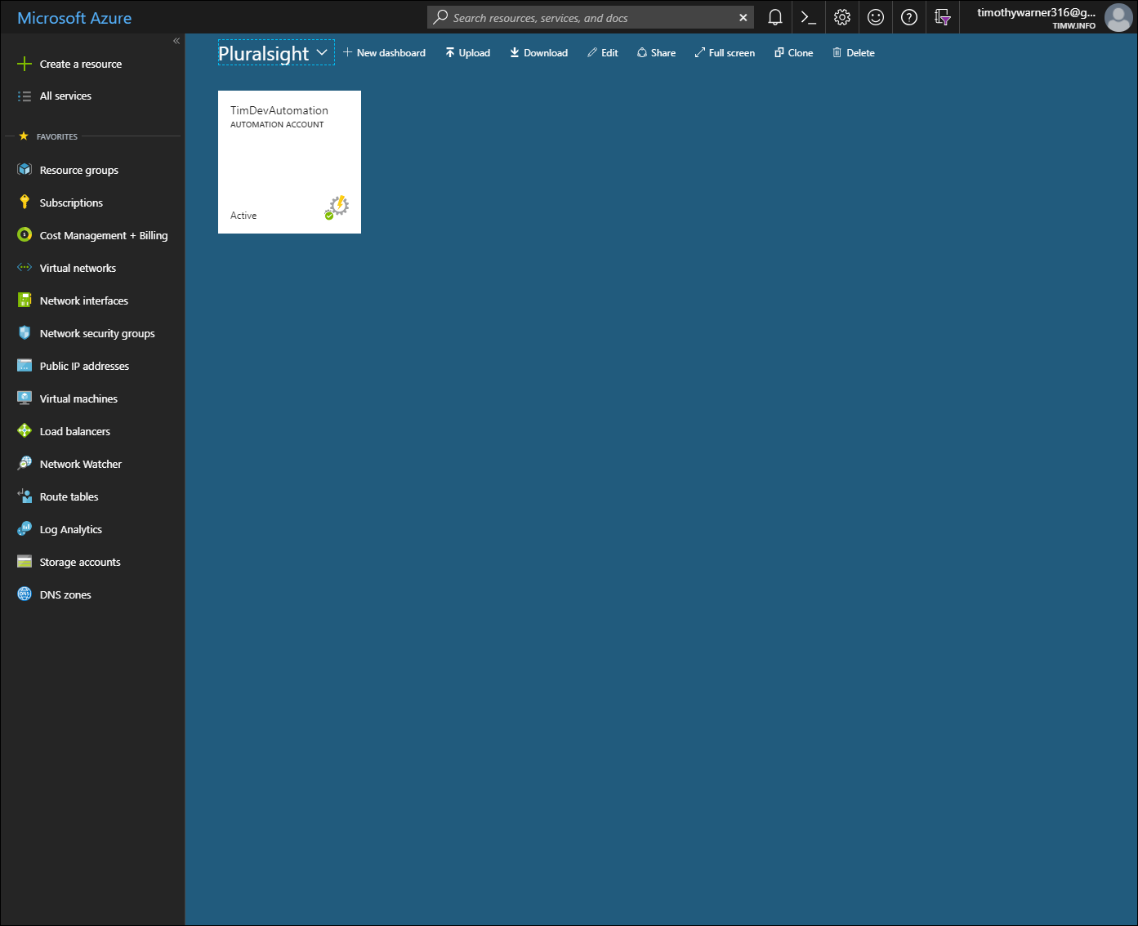
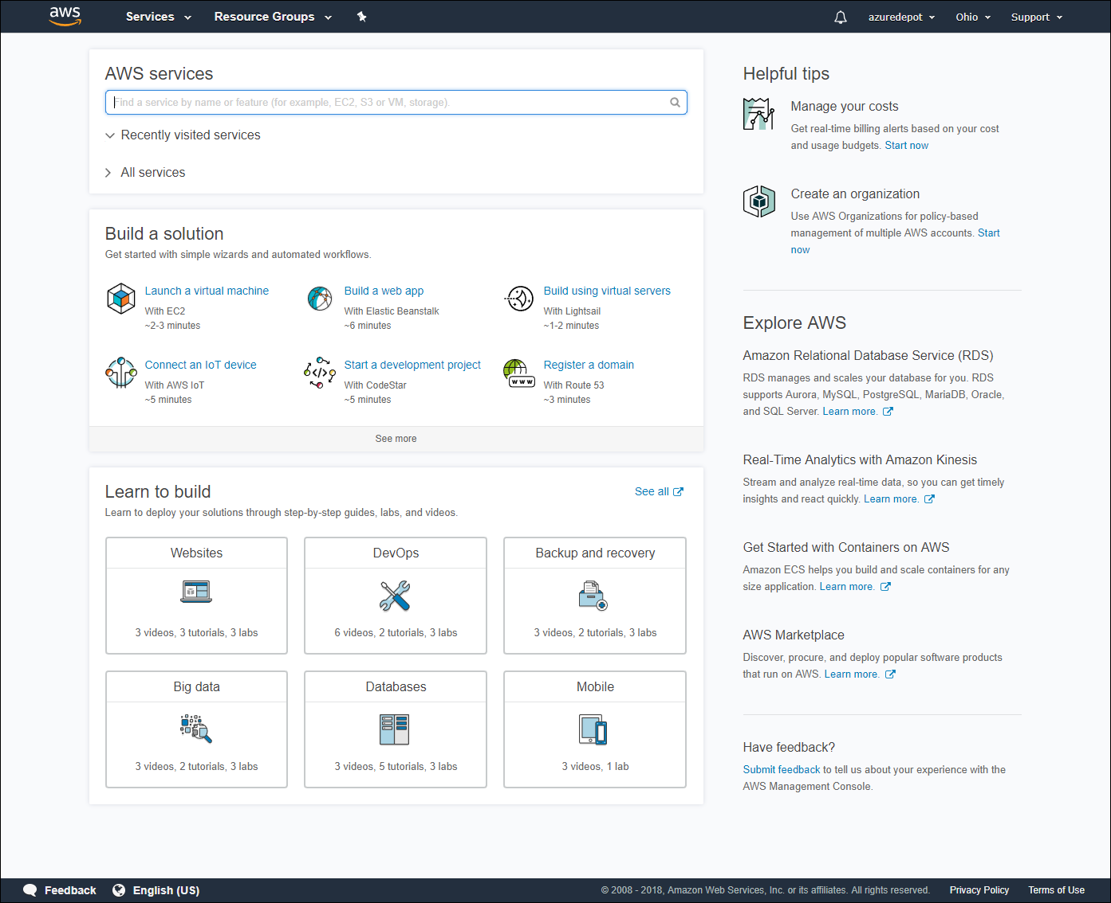
Web Management Portals
Azure
AWS

Slide 19
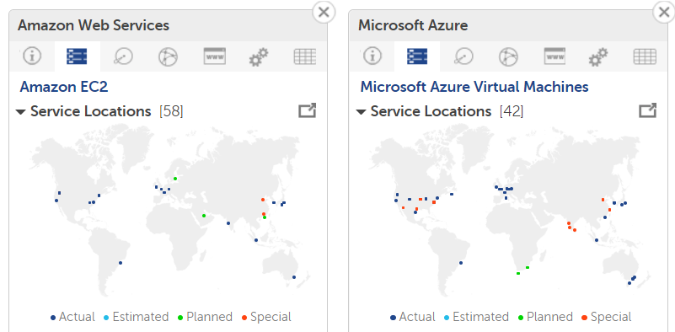
Regions
cloudharmony.com

Slide 20
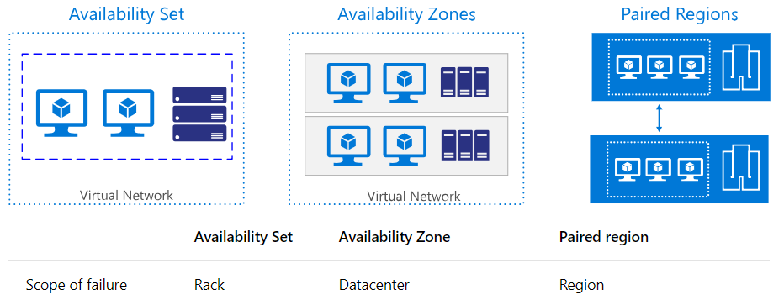
Availability Zones
Availability zones are new-ish Azure feature
Only Azure has availability sets and paired regions

Slide 21
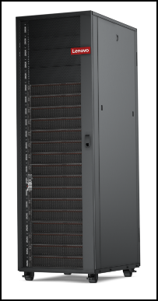
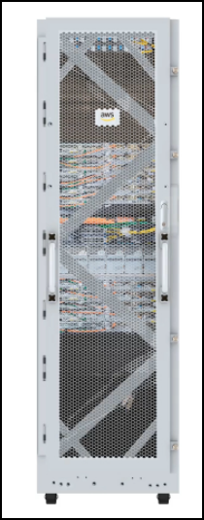
Portable Clouds
Azure Stack Hub
AWS Outposts

Slide 22
Storage

Slide 23
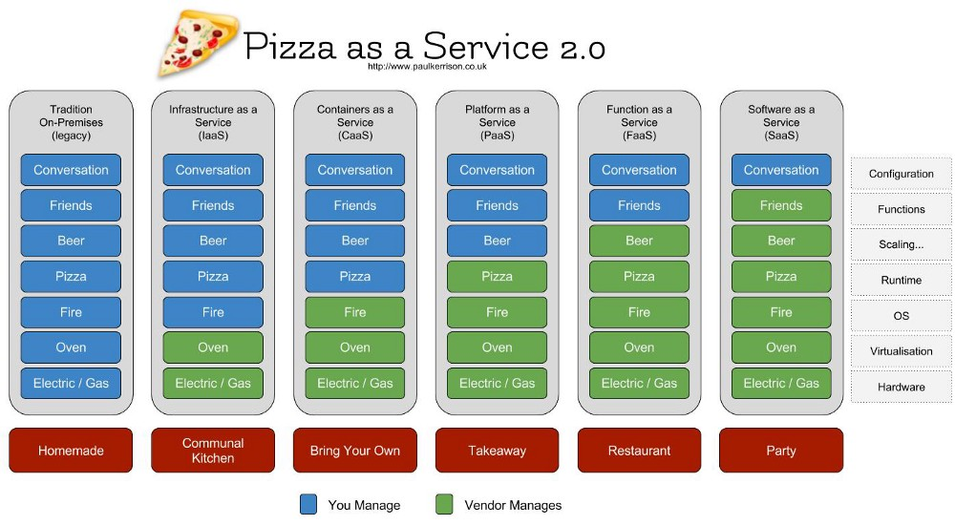
"Pizza as a Service"
timw.info/uc5

Slide 24
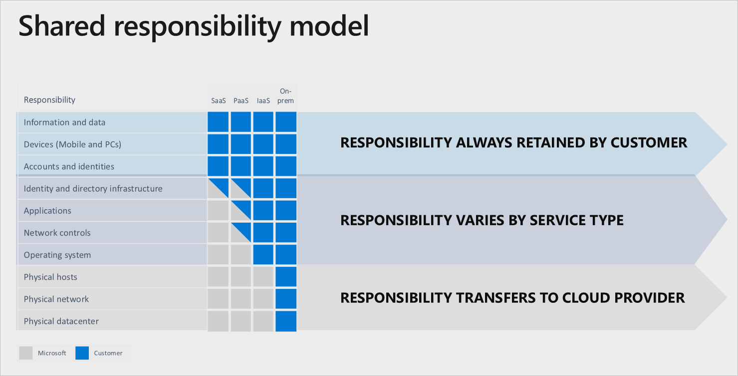
Shared Responsibility Model
timw.info/mpo

Slide 25


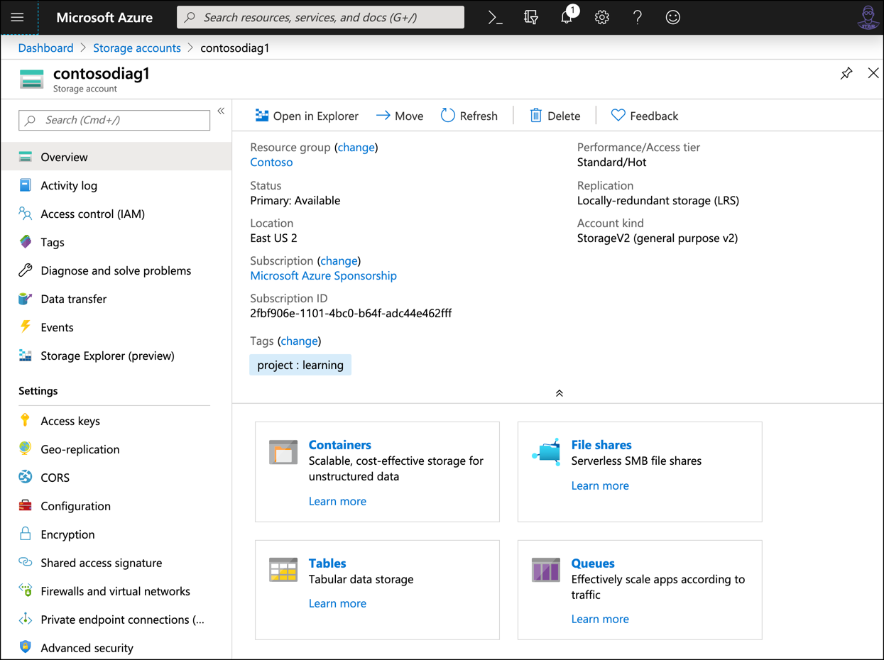
Azure Storage Account
S3
Managed disks
EBS
EFS
SQS
DynamoDB

Slide 26




Storage Shake-out
Feature | Azure | AWS
VM disk storage | Managed disks | EBS
VM backup | Azure Backup | None
DR | ASR | None
Block storage (including hot, cool, and cold tiers) | S3; Glacier | Azure Storage
Hybrid storage | Storage Gateway | StorSimple/Azure Stack Edge
Bulk data transfer | AWS Snowball | Azure Data Box

Slide 27


Database Options
Microsoft Azure
Amazon Web Services
Azure SQL Database
Azure Database for MySQL
Azure Database for PostgreSQL
Azure SQL Database Managed Instance
Azure Cosmos DB
Azure Database Migration Service
Relational Database Service (RDS)
DynamoDB, SimpleDB
AWS Database Migration Service

Slide 28


Relational Databases
Azure
AWS
Azure SQL Database
Azure SQL DB Managed Instance
Azure DB for MySQL
Azure DB for PostgreSQL
RDS
Amazon Aurora
PostgreSQL
MySQL
MariaDB
Oracle
SQL Server

Slide 29


Non-Relational Databases
Azure
AWS
Cosmos DB (Multi-model)
Azure Redis Cache
Dynamo DB (document)
SimpleDB (key-value)
ElastiCache

Slide 30

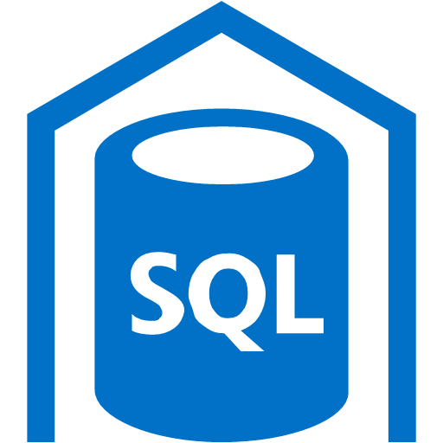
Big Data
Azure
AWS
SQL Data Warehouse
HDInsight
Data Factory
Data Lake
Redshift
Elastic MapReduce (EMR)
Data Pipeline
Kinesis Analytics

Slide 31
Compute and Networking

Slide 32


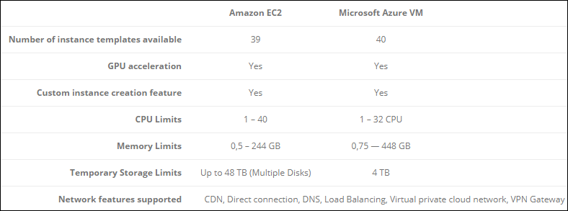
Amazon EC2 vs. Azure VM
timw.info/cb1

Slide 33


Container instances (EC2 Container Service vs. Azure Container Instances)
Container orchestration (EKS vs. AKS)
Serverless compute (Lambda vs. Azure Functions)
Other Compute Layers

Slide 34
Microsoft sunsetted RemoteApp in Azure
They directed you to Citrix XenApp or RDS as IaaS VMs
Now we have Windows Virtual Desktop (WVD)
AWS Workspaces
App/Desktop Virtualization

Slide 35


Network Technology
Azure
AWS
Virtual network
Network security groups
AWS VPN Gateway
Virtual Private Cloud (VPC)
Security groups
Azure VPN Gateway

Slide 36


Hybrid Cloud Differentiation
Azure
AWS
Azure AD Connect
Active Directory Federation Services (AD FS)
Azure Stack
AWS Directory Service
AD Connector

Slide 37
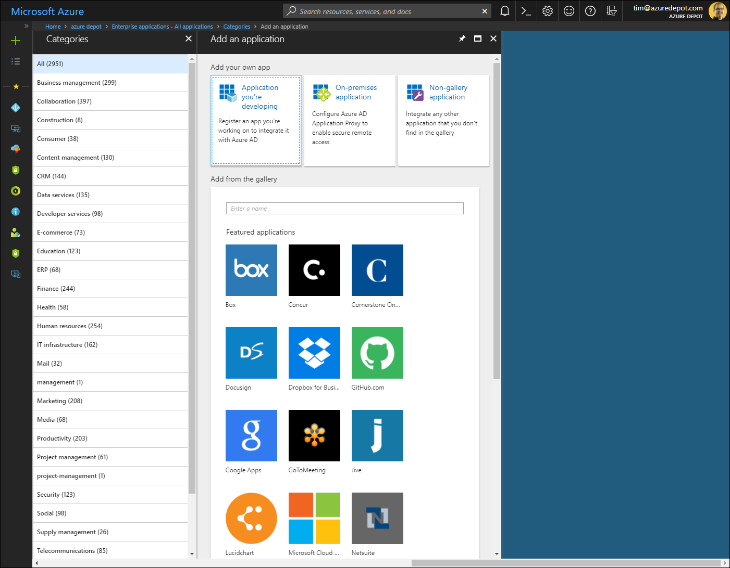
Azure SaaS SSO Integrations

Slide 38
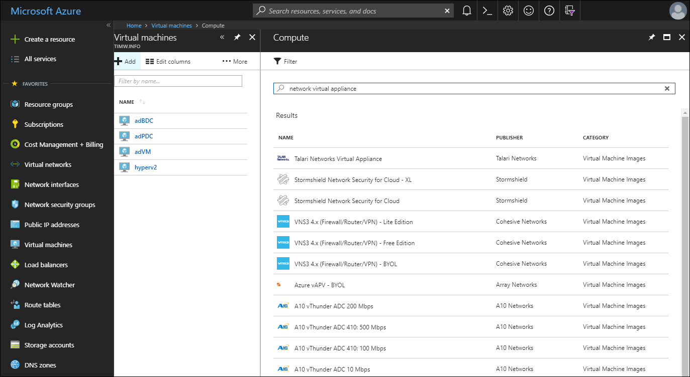
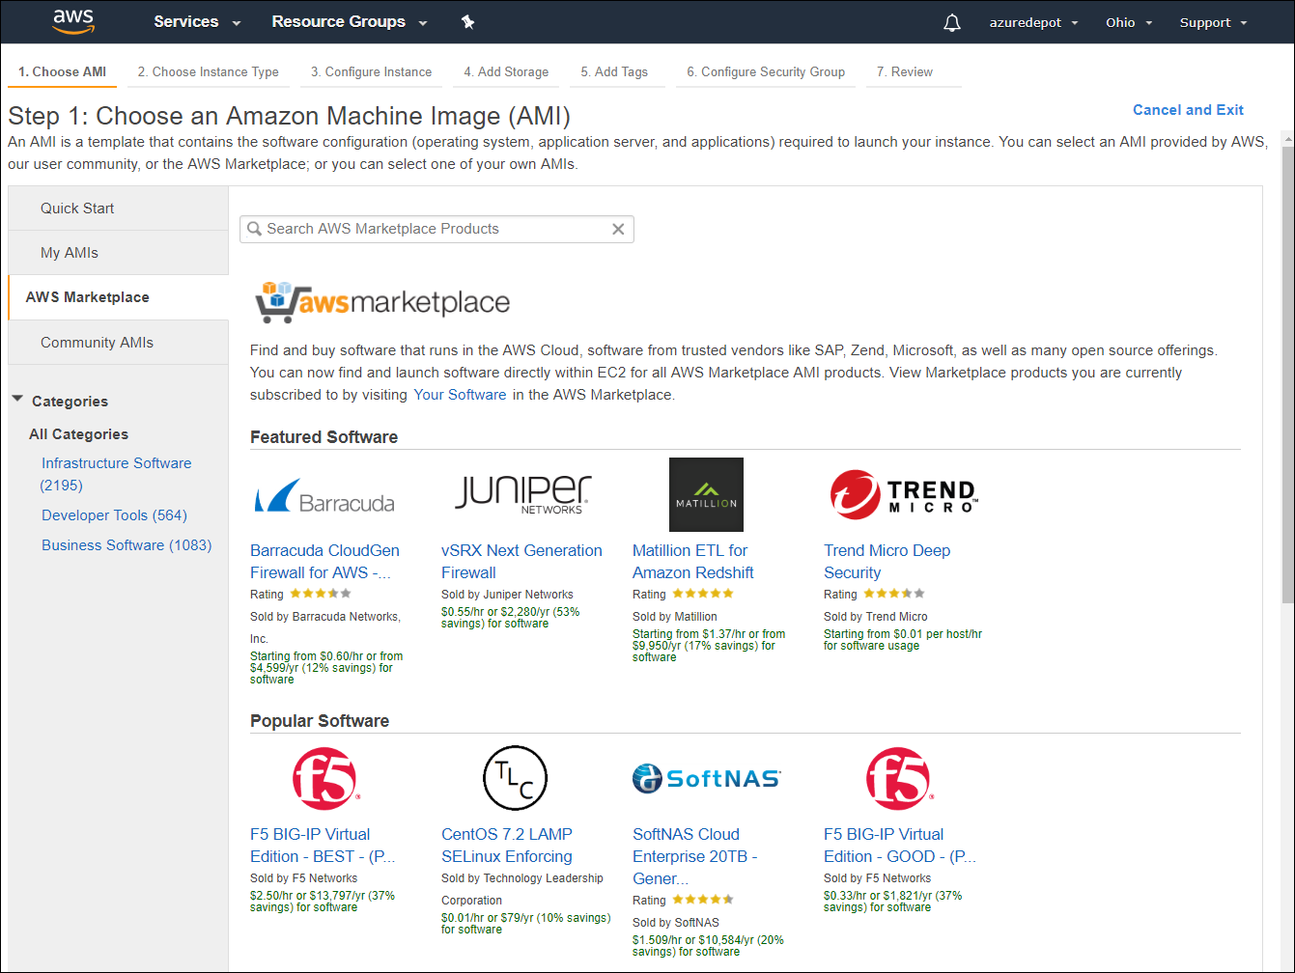
Marketplace/Network Virtual Appliances
Azure
AWS

Slide 39
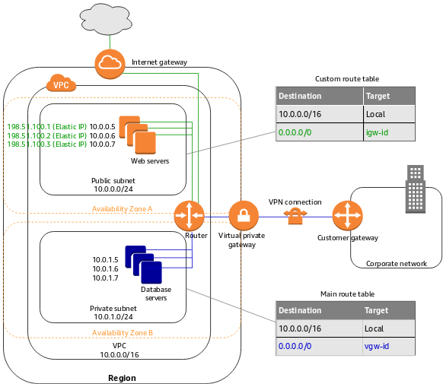
AWS Virtual Private Cloud (VPC)

Slide 40
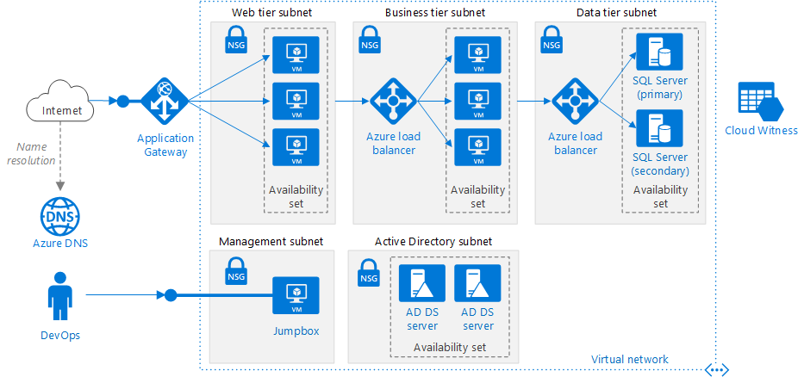
Azure Virtual Network (VNet)

Slide 41
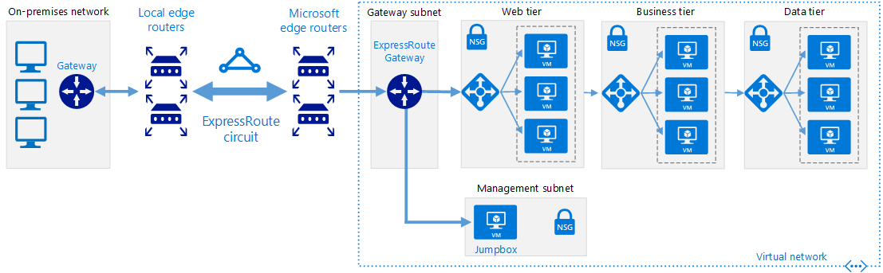
Azure Hybrid Cloud

Slide 42
Identity and Security

Slide 43
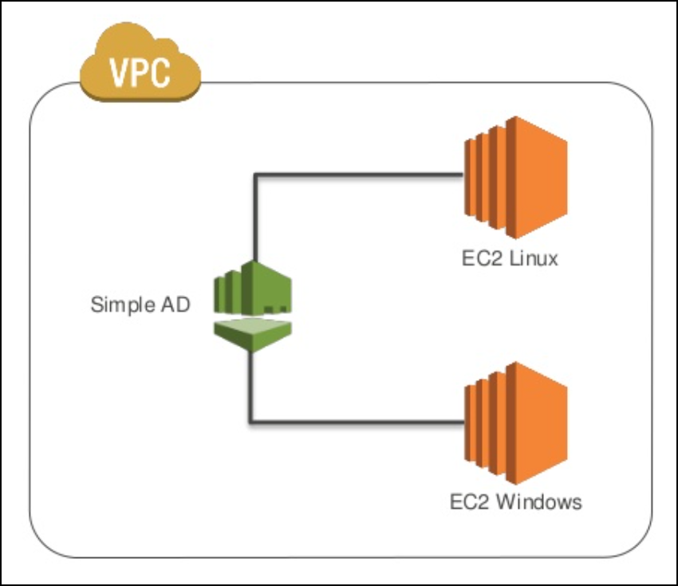
Simple AD
Samba 4 directory in AWS

Slide 44
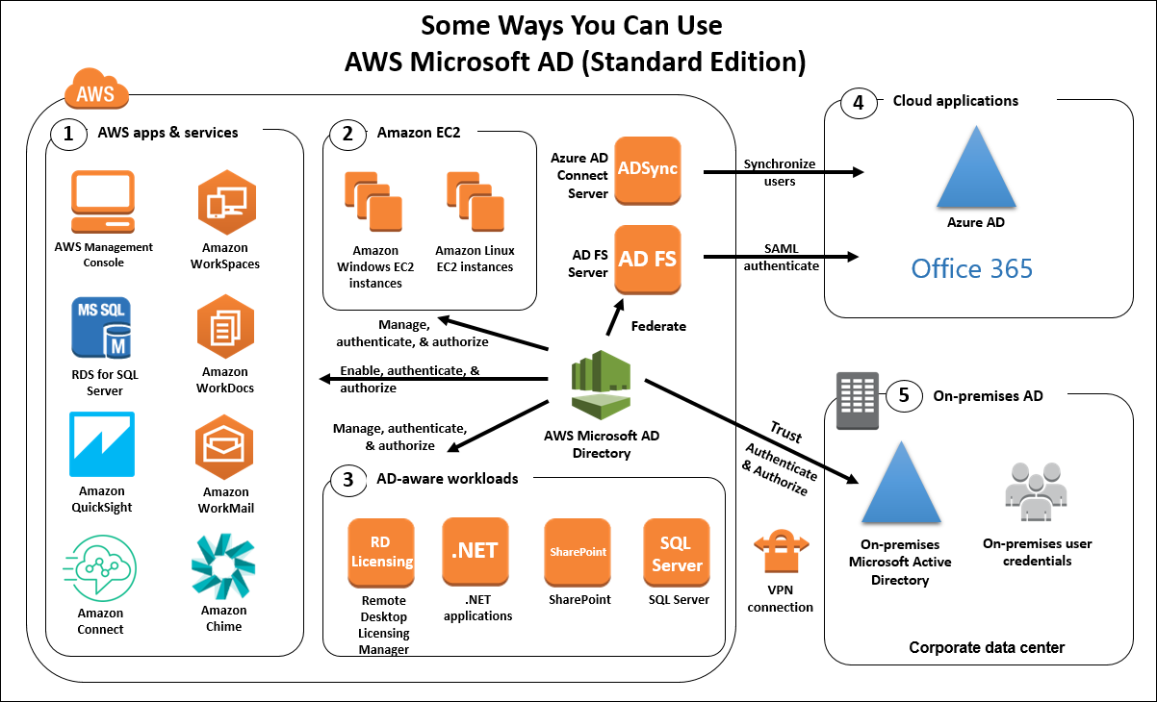
AWS Directory Service

Slide 45
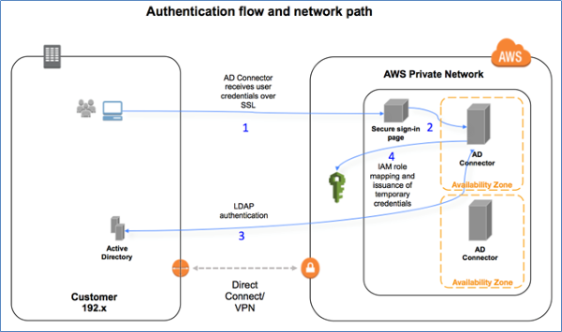
AD Connector

Slide 46
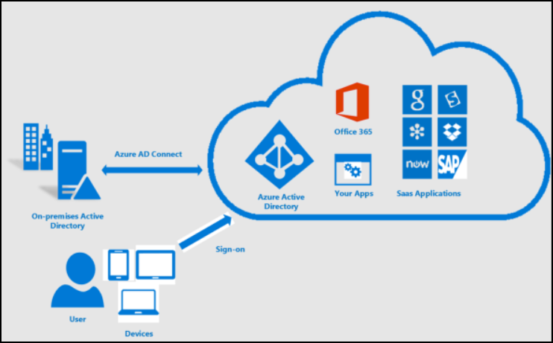
Azure AD Connect

Slide 47
Monitoring

Slide 48

Azure Monitor

Slide 49
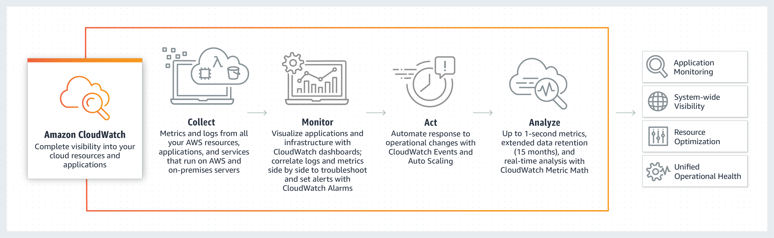
AWS CloudWatch

Slide 50
Pricing, Governance, Compliance

Slide 51
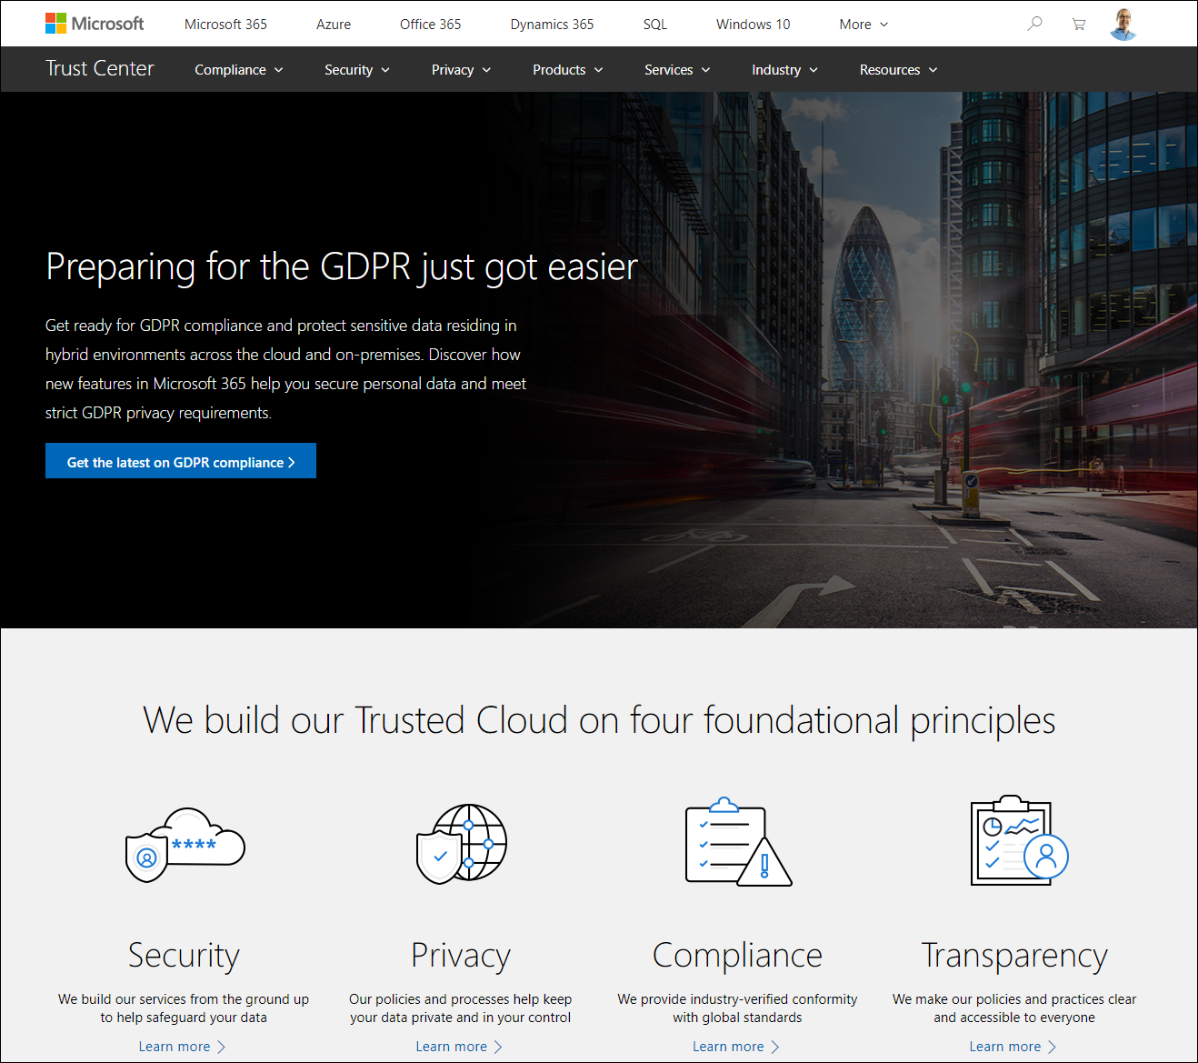
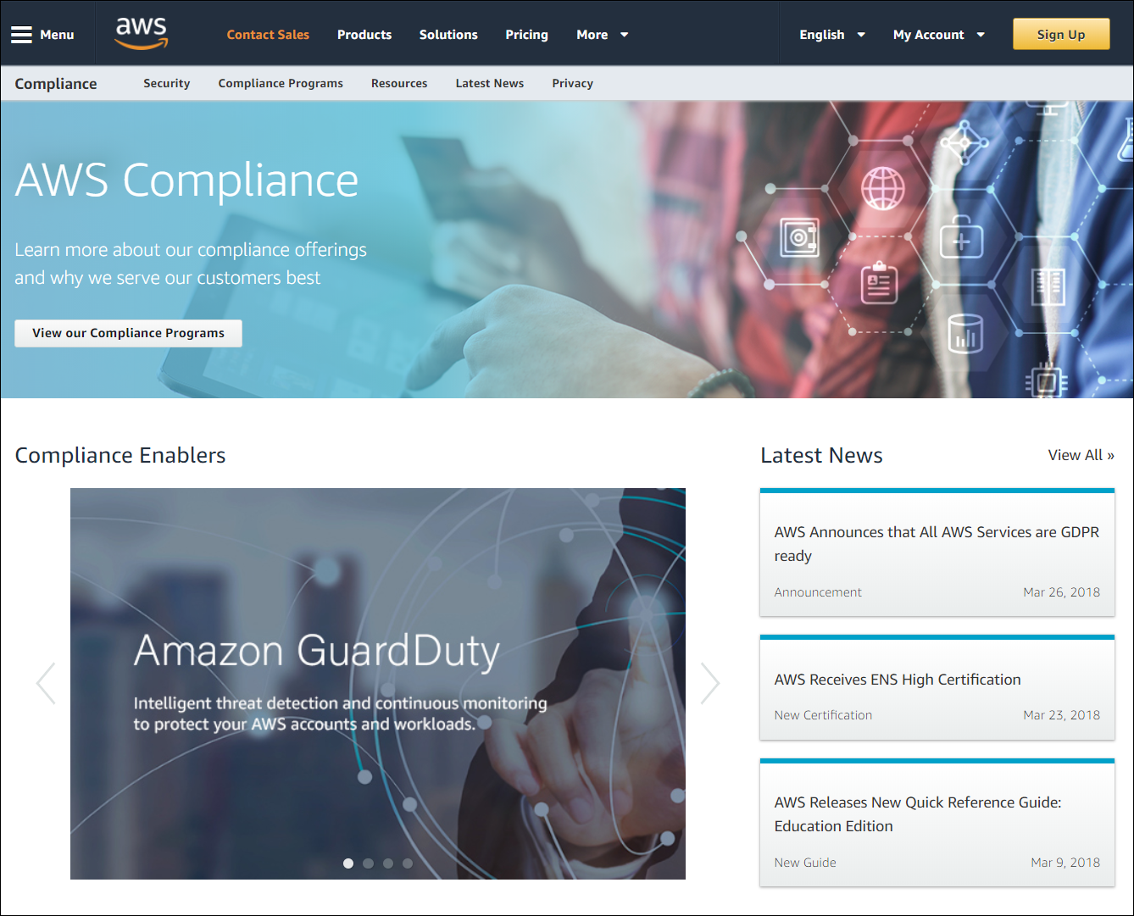
Compliance and Trust
Azure
AWS
timw.info/zkb
timw.info/hwl

Slide 52
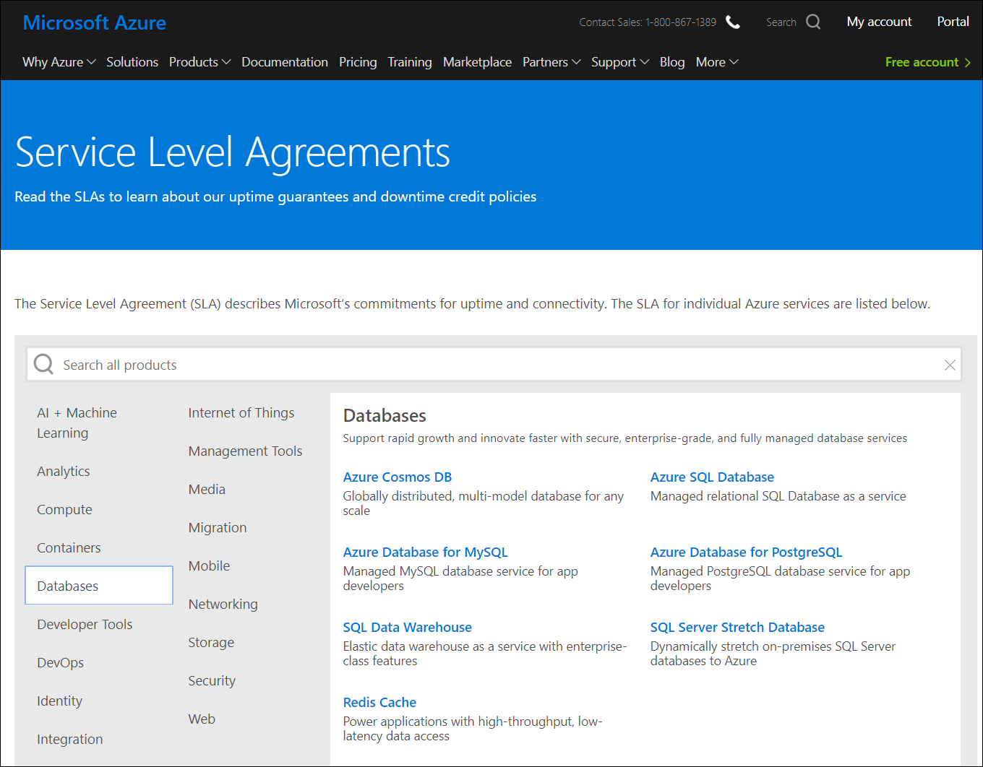
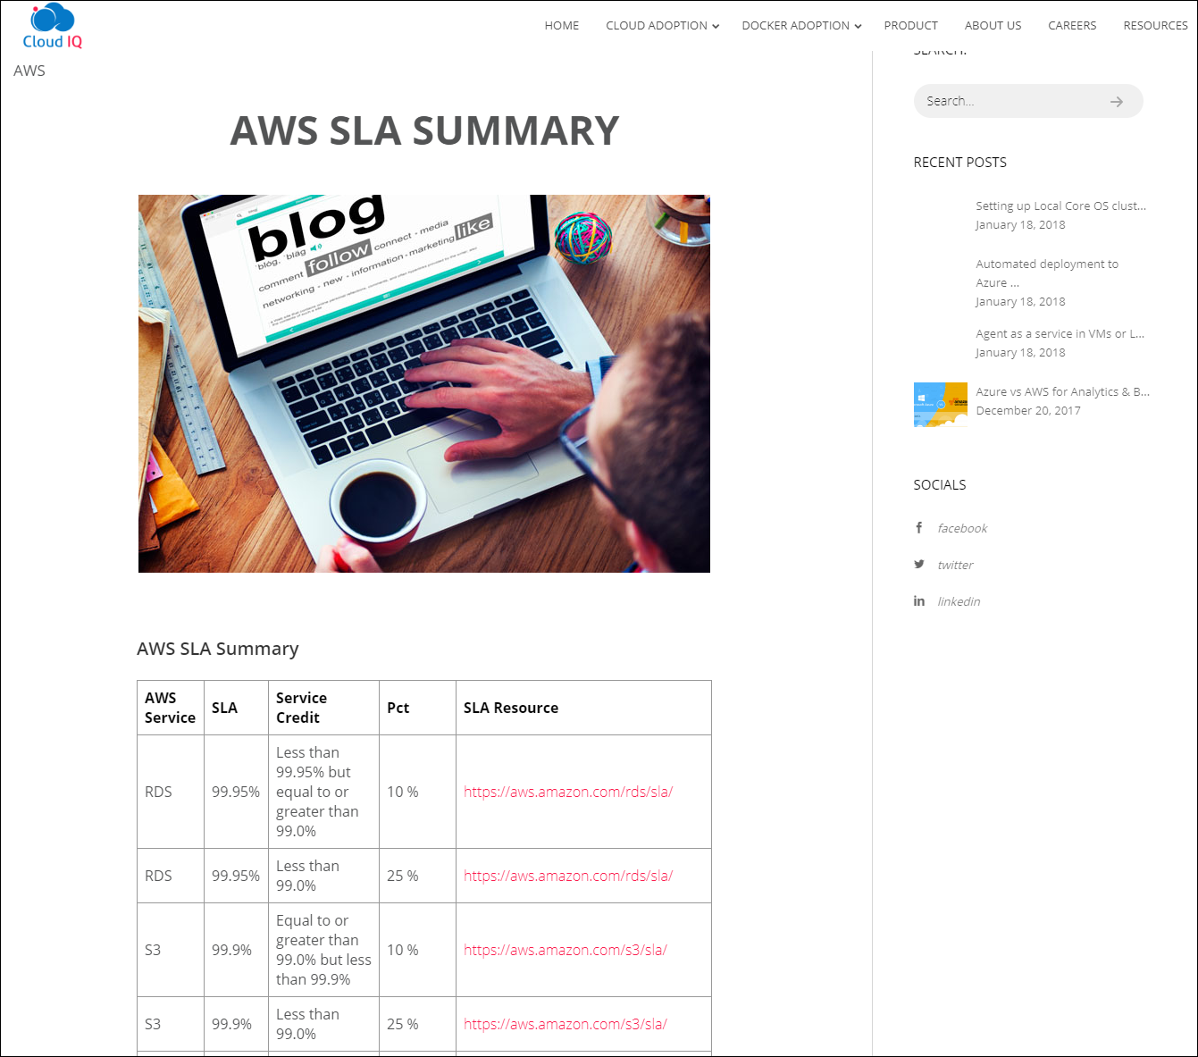
Service-Level Agreements (SLAs)
Azure
AWS
timw.info/sla1
timw.info/qaw

Slide 53
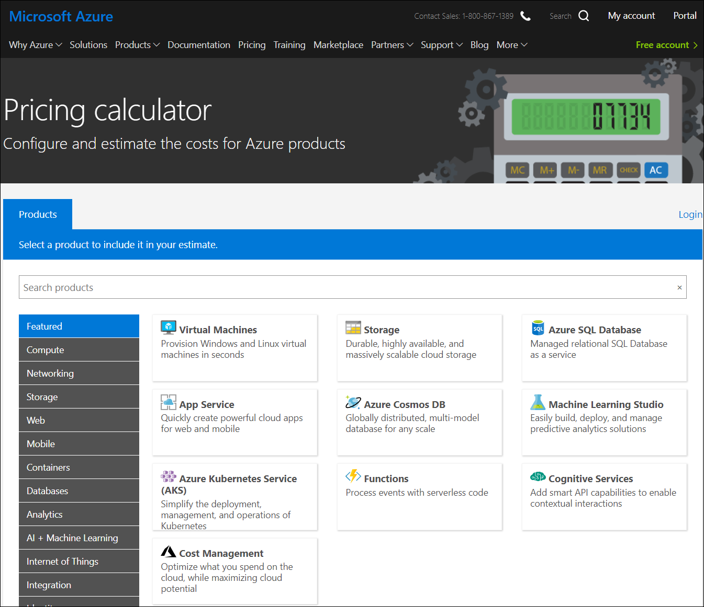
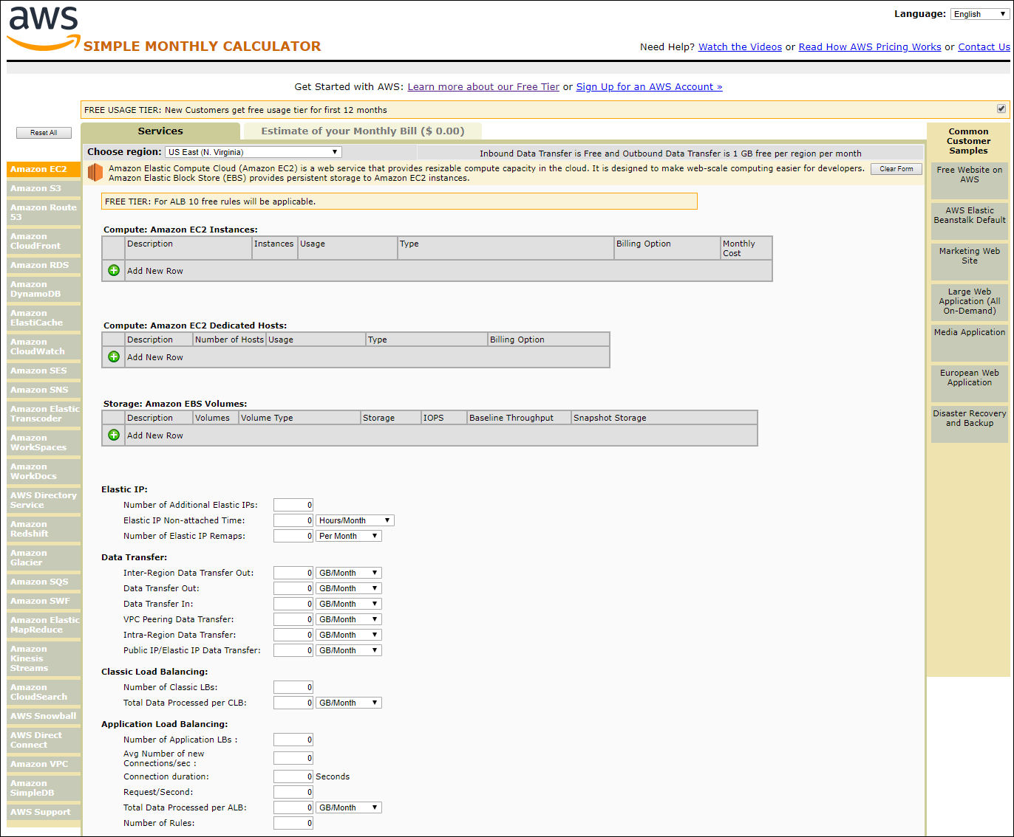
Cloud Calculators
Azure
AWS

Slide 54
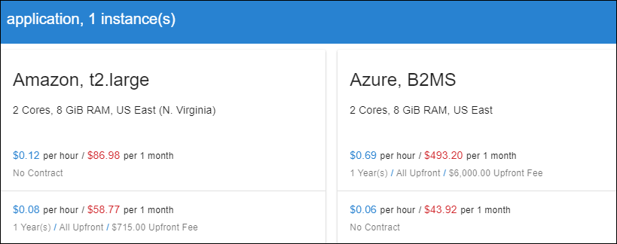

calculator.unigma.com
Both clouds have reserved instance pricing

Slide 55
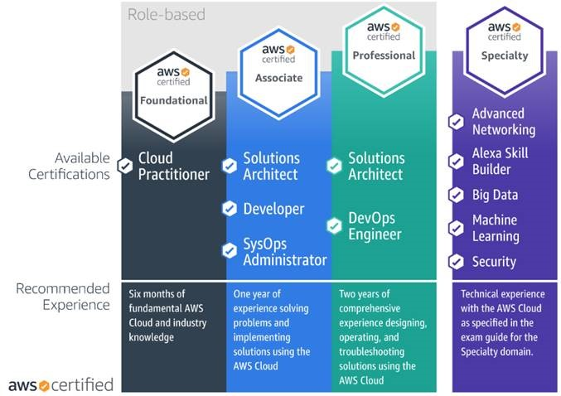
AWS Certification

Slide 56
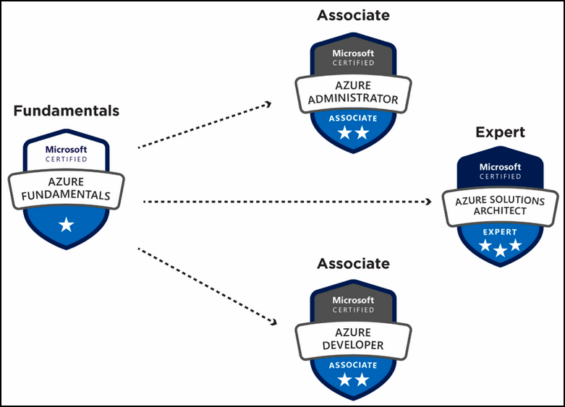
Azure Certification

